Slide 1
OOP SEMESTER PROJECT ticket reservation
21SW056 : Fahad Hussain

Slide 2
introduction
This is a simple project which has two functionalities and uses concepts studied in this course.
Threading
Exception Handling
Associations
Etc.

Slide 3
Functionalities
There are two sections of this application
Admin: Where the CRUD operations of the flights are handled.
User: Where the flights can be booked.

Slide 4
Classes
BookingInfo(passenger's information)
Flight (flight info)

Slide 5
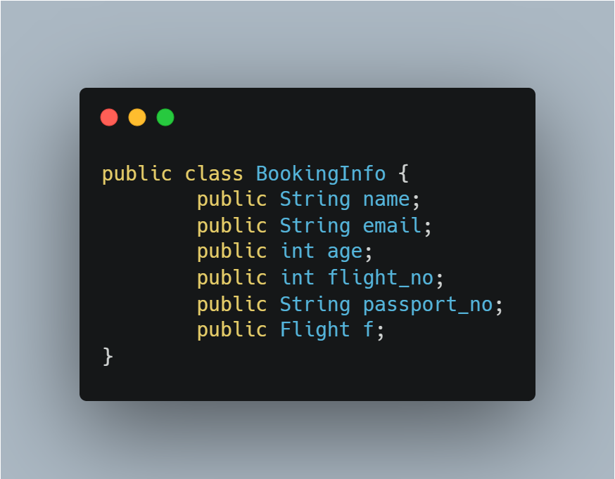
Bookinginfo

Slide 6
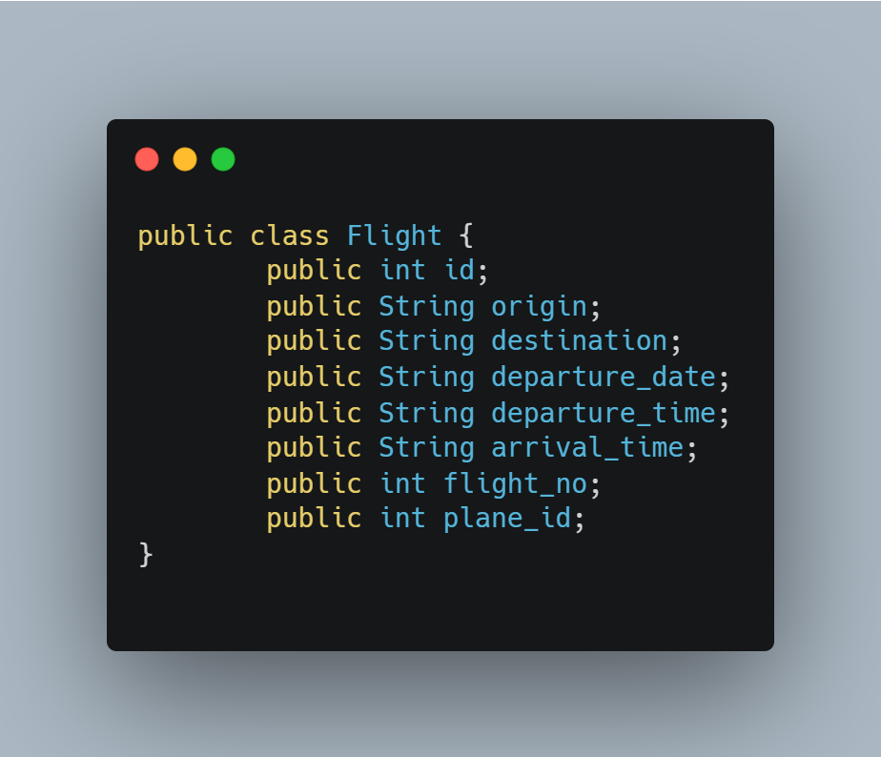
Flight

Slide 7
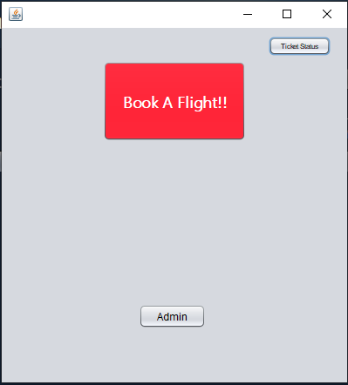
HOme screen

Slide 8
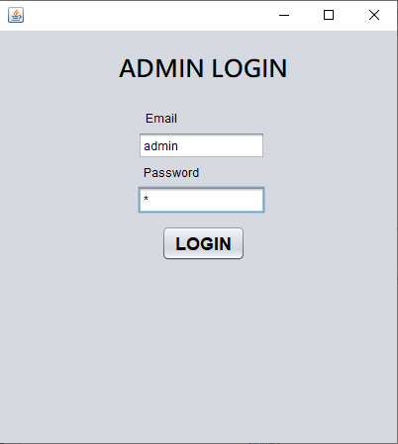
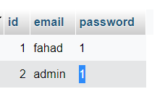
Admin login

Slide 9
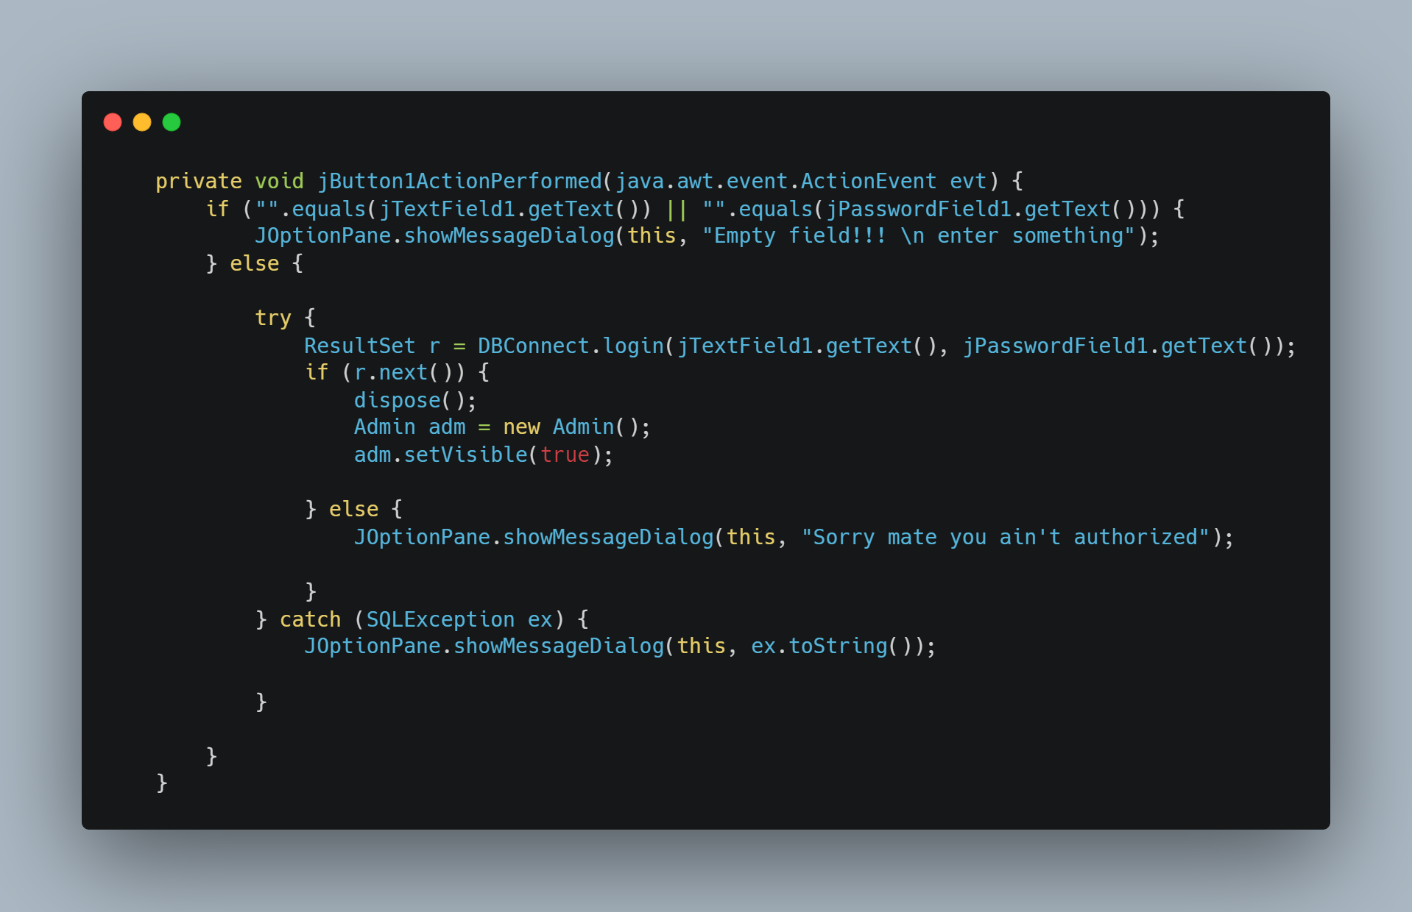
Login button logic

Slide 10
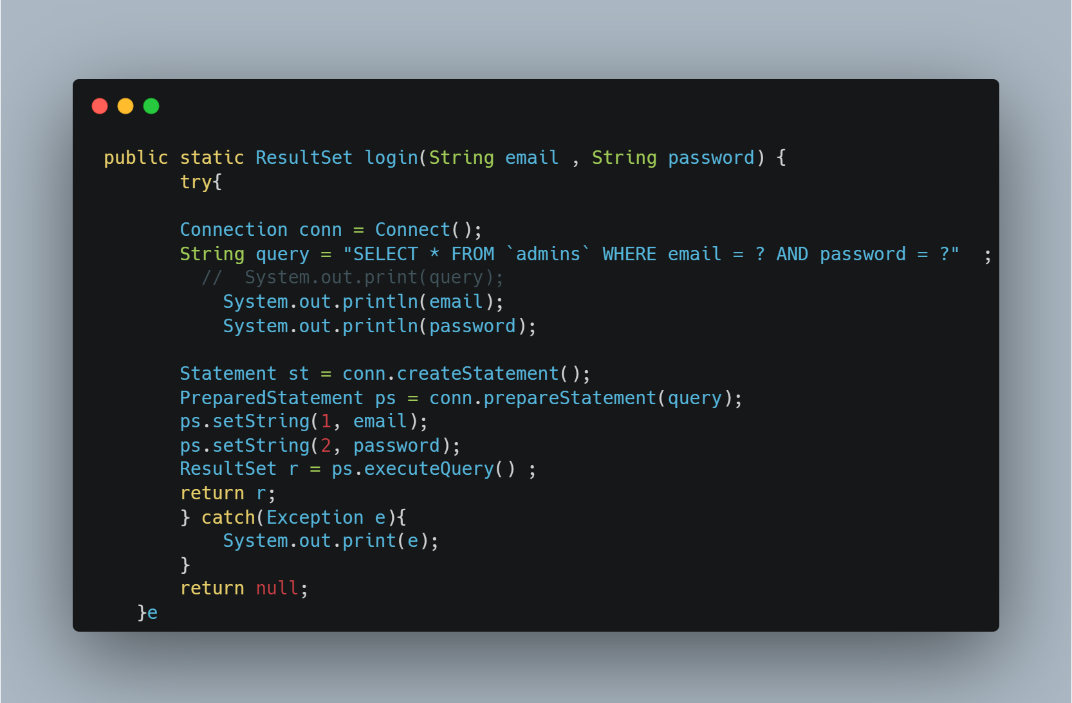
Login logic (Contd)

Slide 11
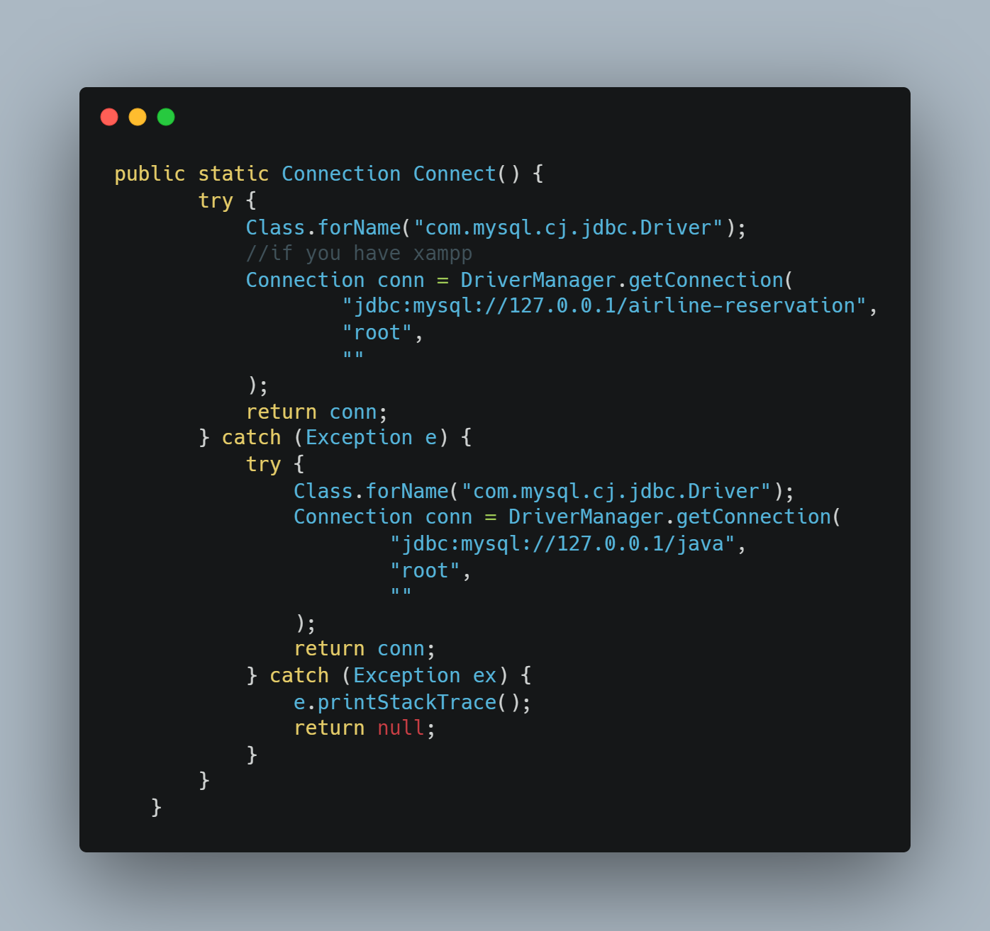
Connect() function

Slide 12
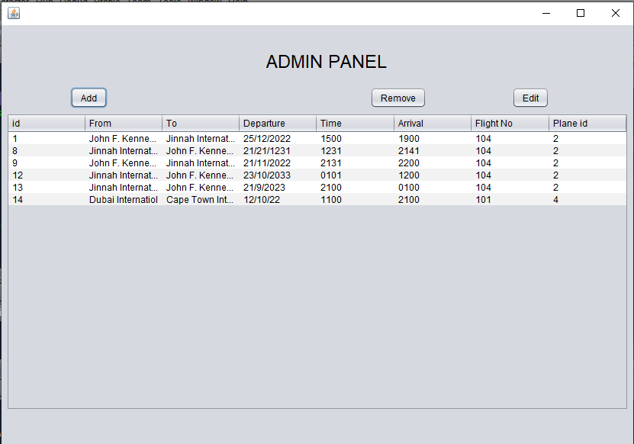
Admin Panel

Slide 13
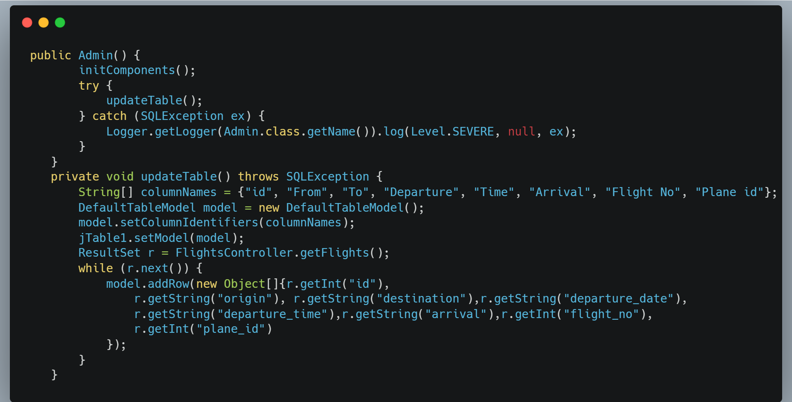
Admin panel initialization

Slide 14
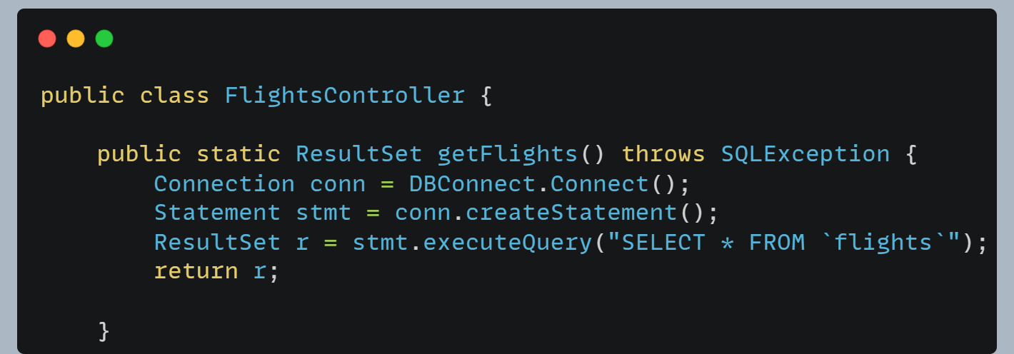
Admin panel initialization (Contd)

Slide 15
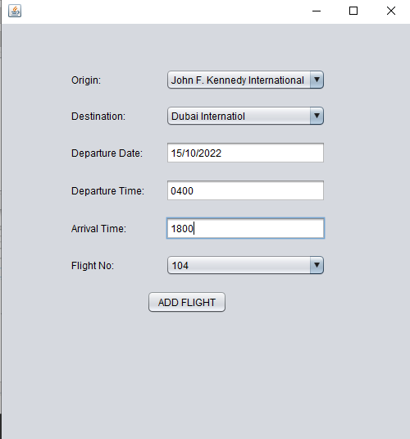
Add flight form

Slide 16
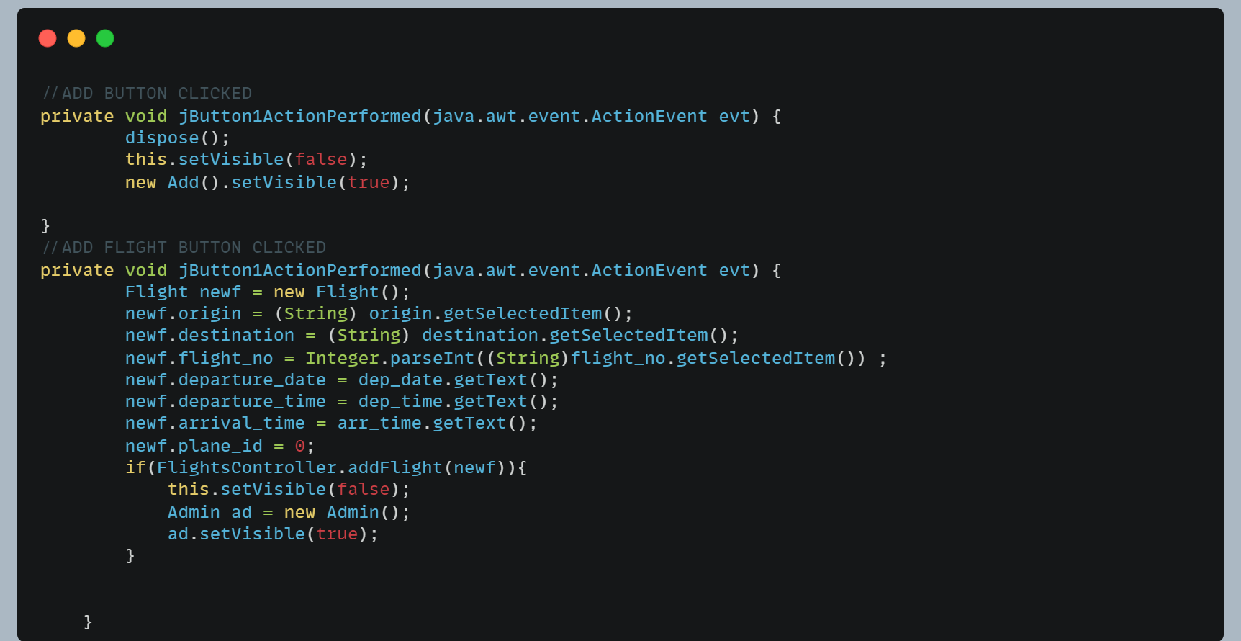
Add flight logic

Slide 17
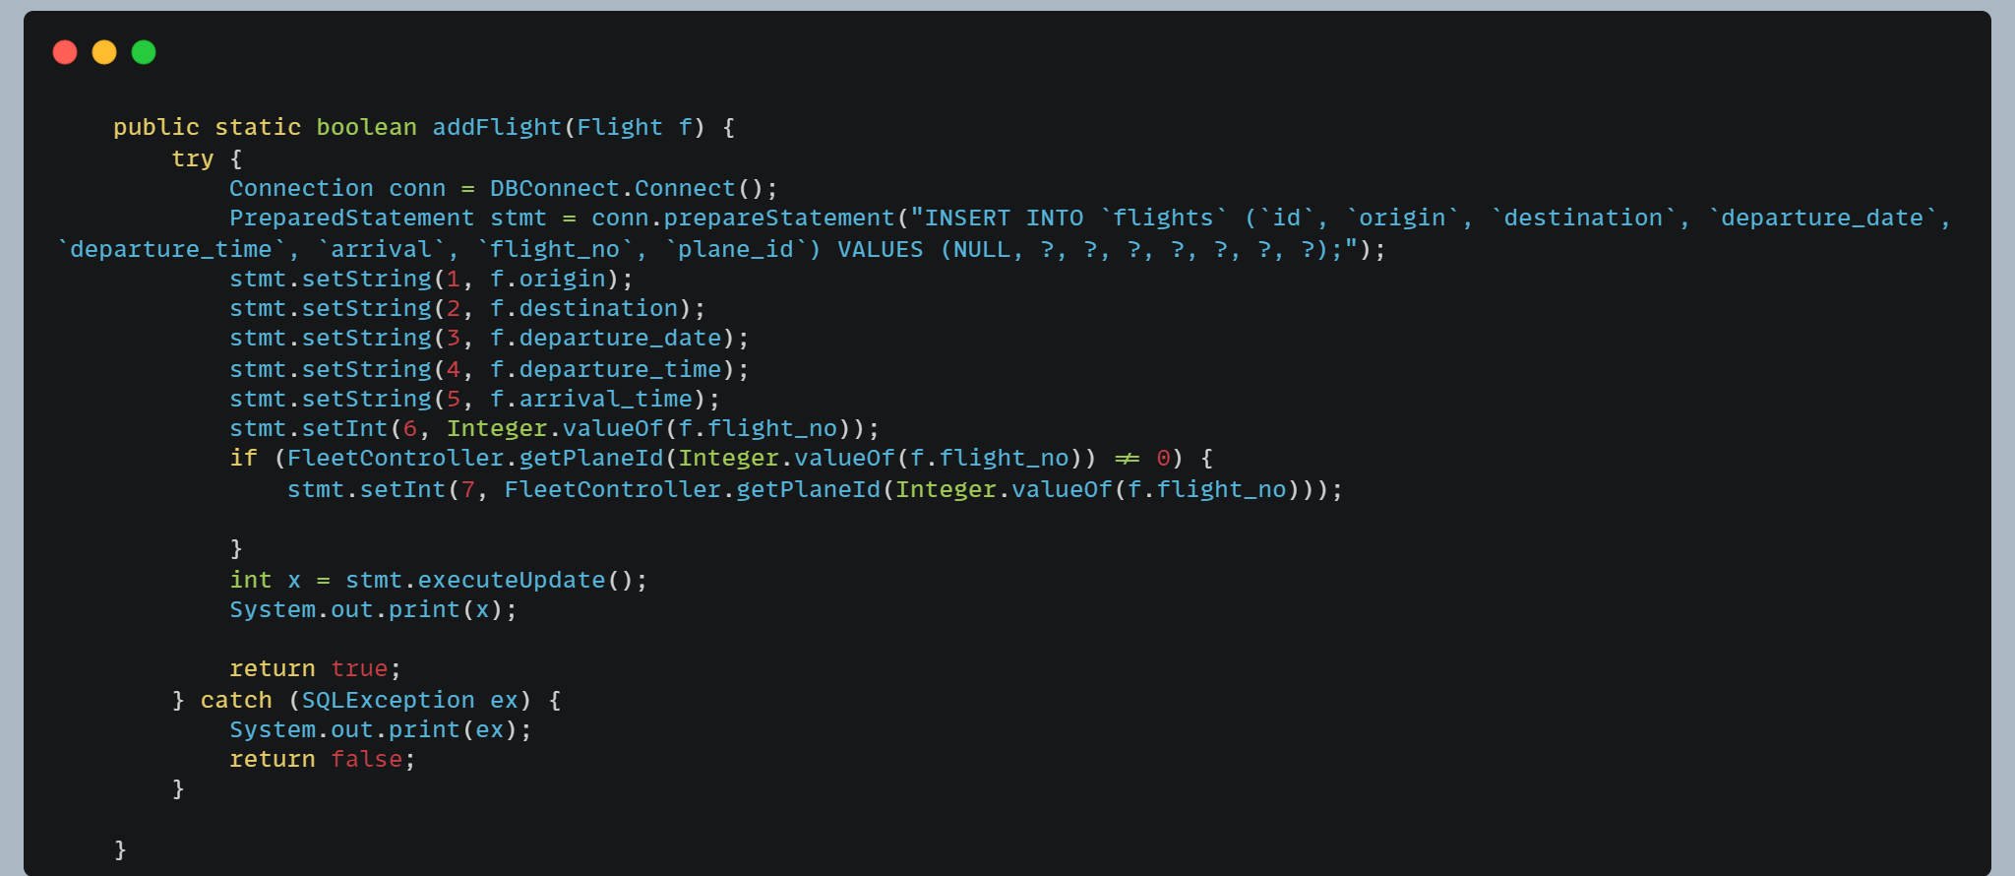
ADD flight logic (contd)

Slide 18
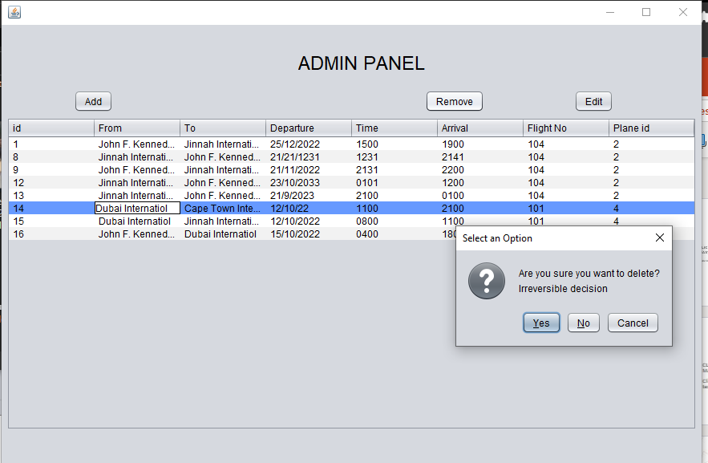
Remove button

Slide 19
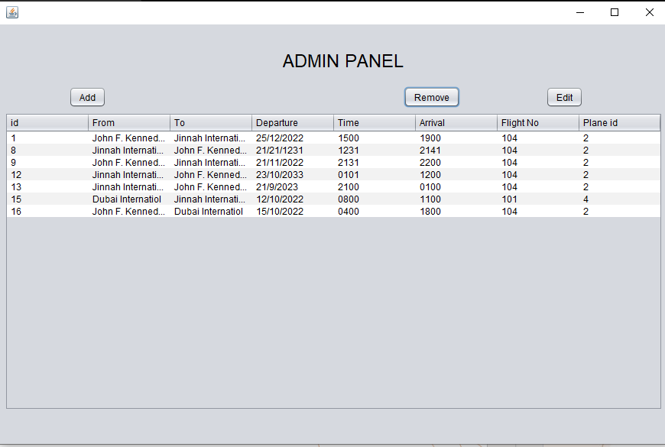
After clicking remove

Slide 20
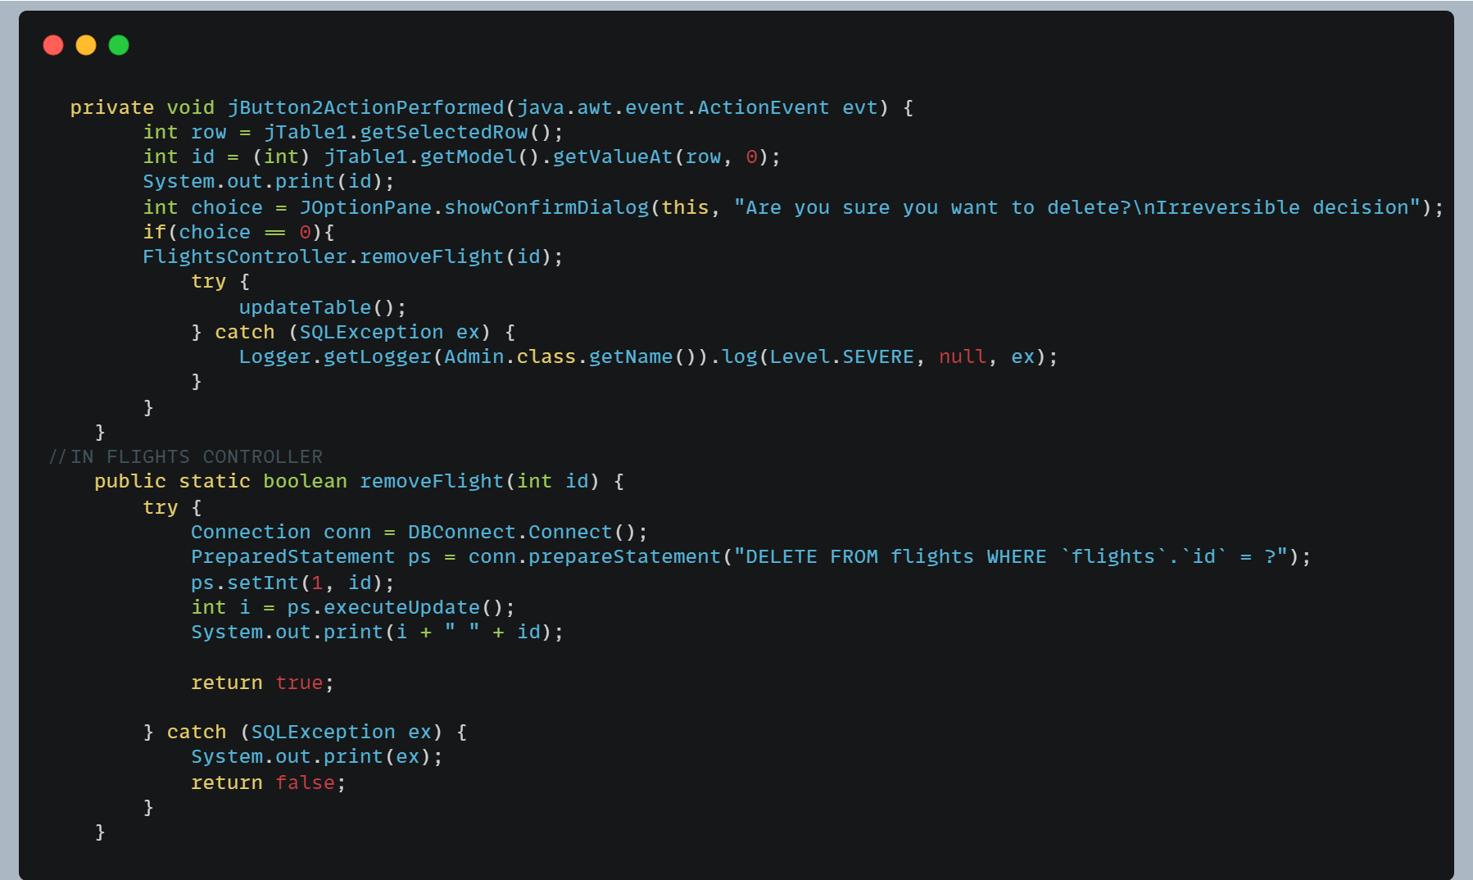
REMOVE BUTTON LOGIC

Slide 21
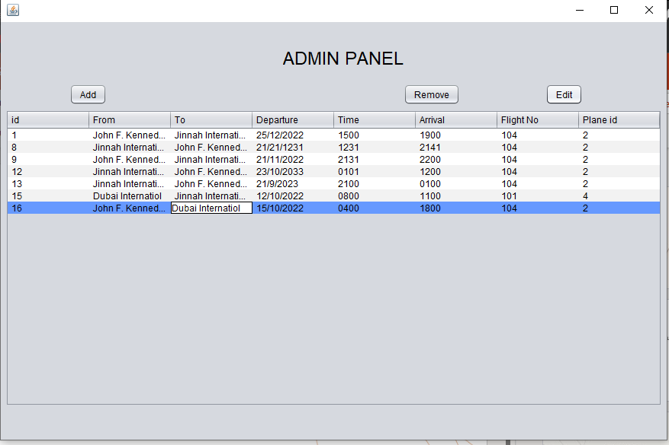
Edit button (clicked

Slide 22
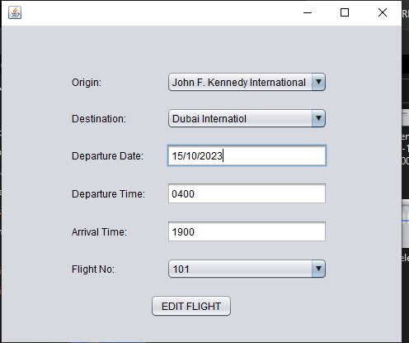
Edit form (data updated)

Slide 23
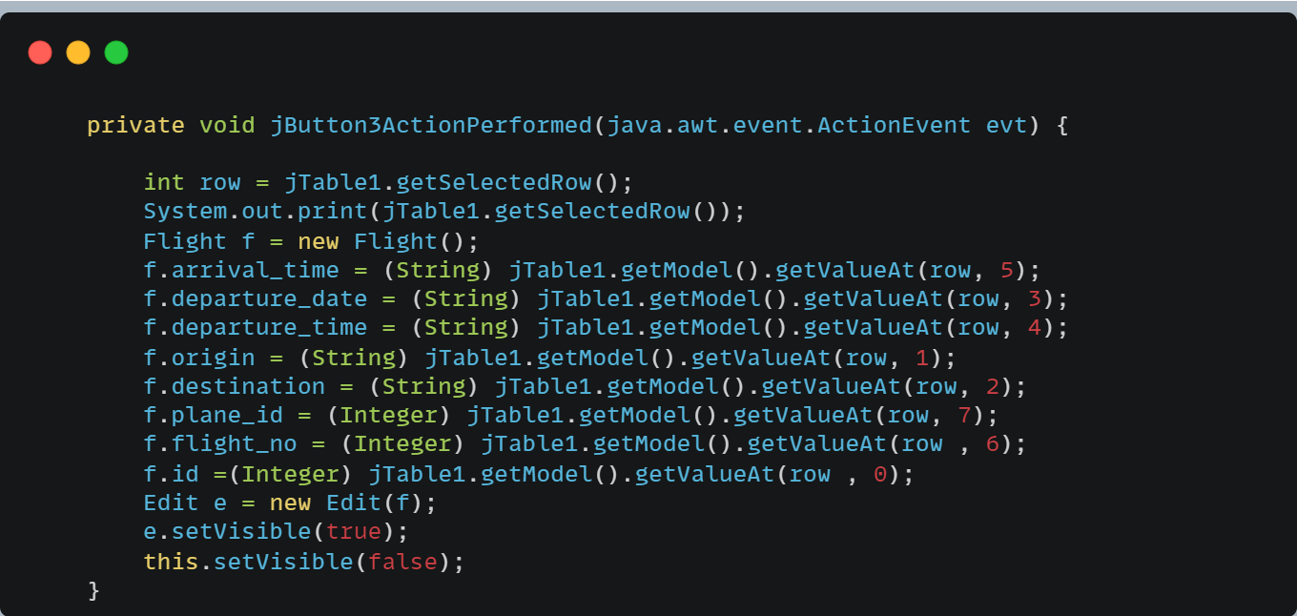
Edit button logic

Slide 24
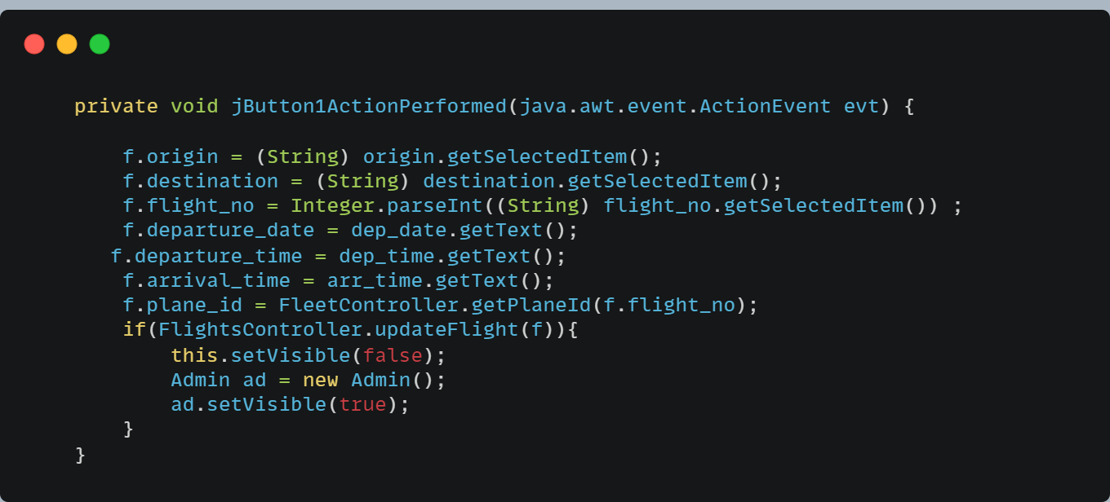
Edit button logic (contd)

Slide 25
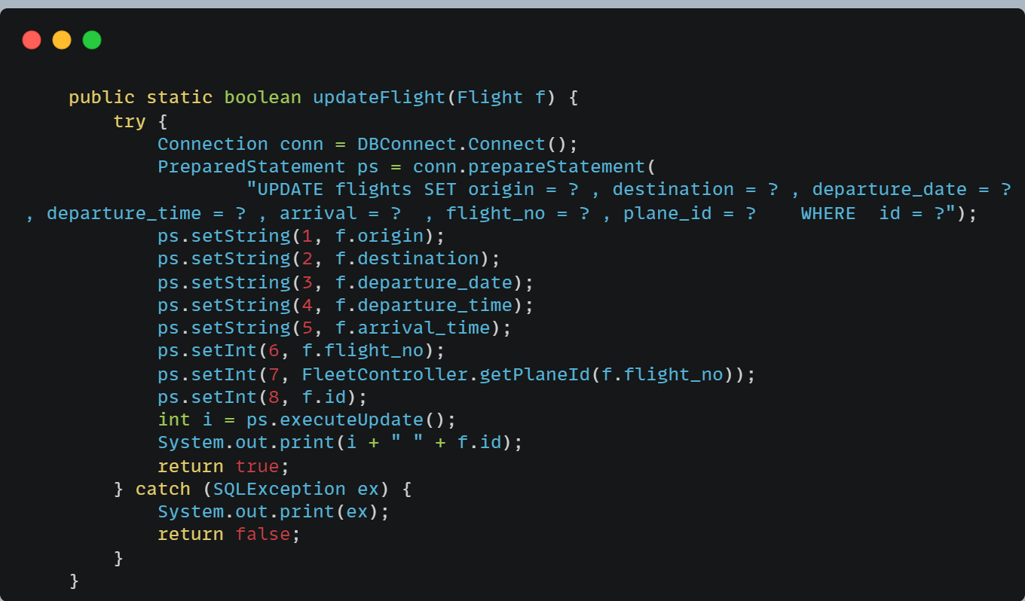
Edit logic db query

Slide 26
Book flight option

Slide 27
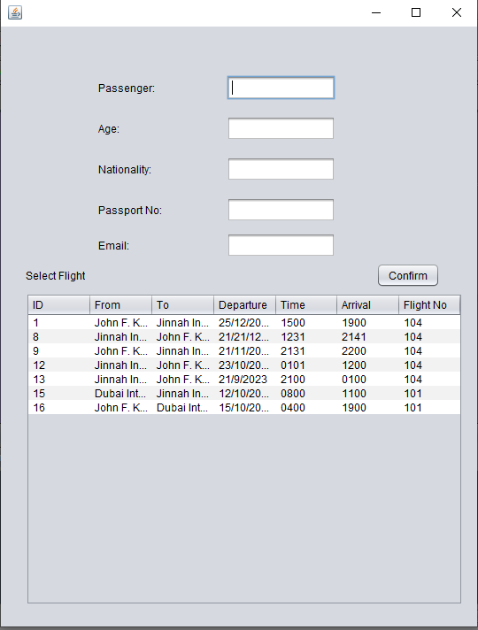
Book flight form

Slide 28
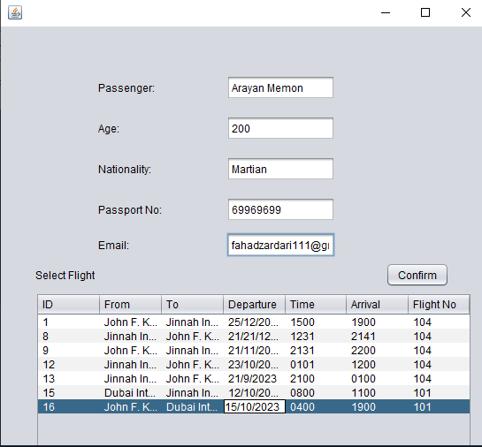
Booking data added

Slide 29
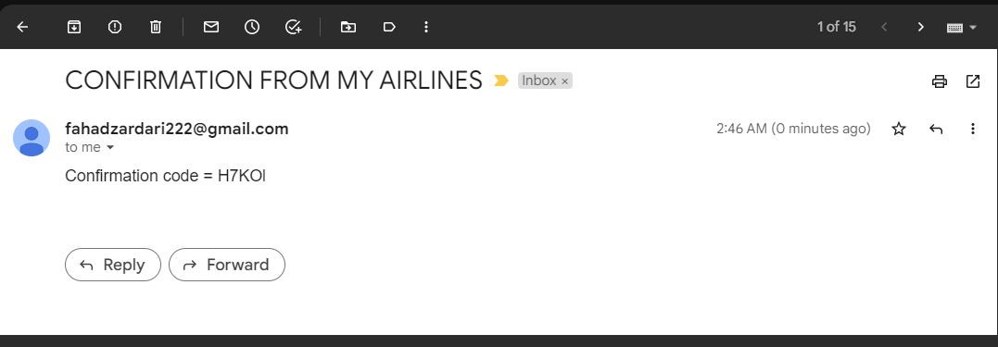
Confirmation code sent

Slide 30
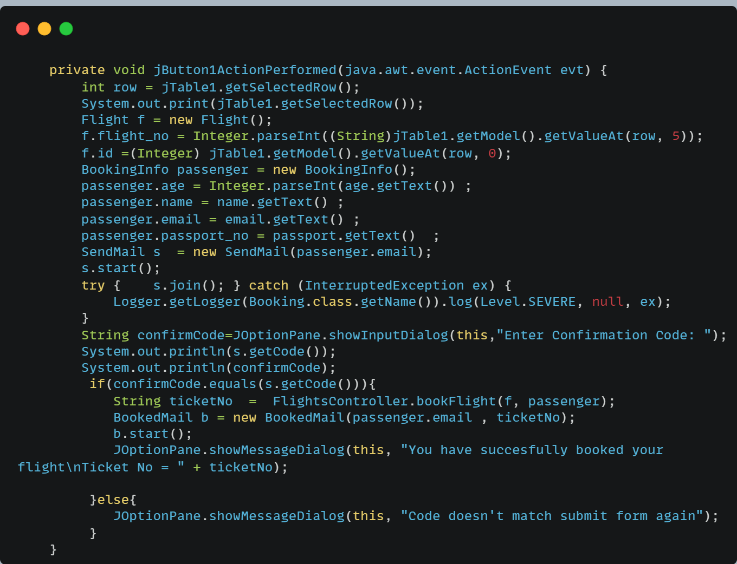
Confirm button logic

Slide 31
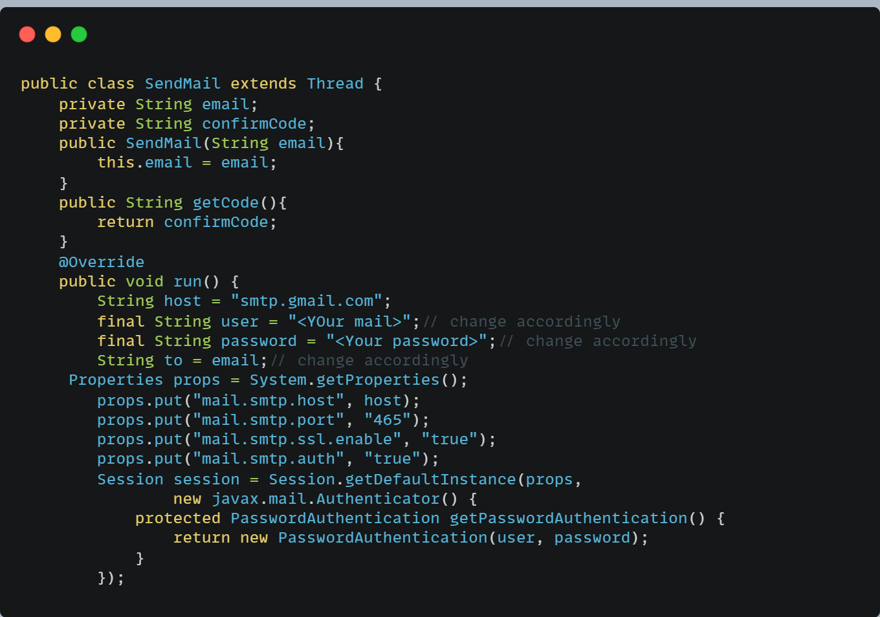
Sendmail.java

Slide 32
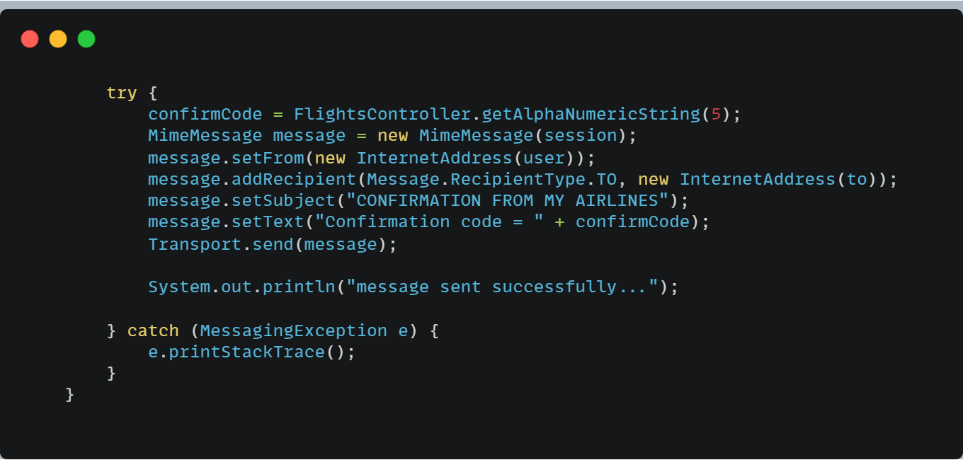
Sendmail.java (cont)

Slide 33
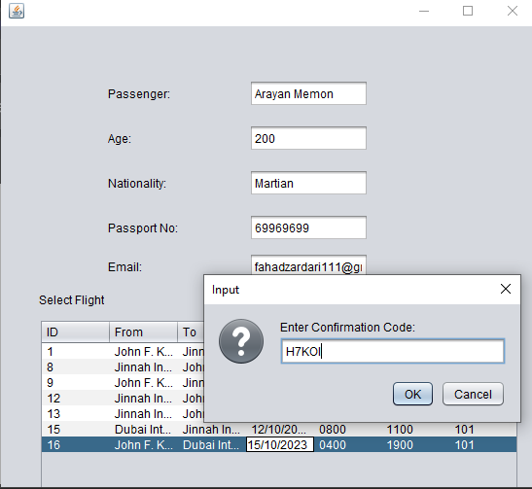
Confirm entered

